Slide 1

Customer Churn Prediction & Retention Dashboard
SQL + Python + Power BI Integration

Slide 2



Project Overview & Objectives
Customer retention is crucial for subscription-based businesses. This project uses SQL, Python, and Power BI to predict churn and uncover insights to improve retention.
The company lacks a system to proactively track churn drivers, leading to reactive decision-making.
Problem Statement:How can we identify at-risk customers and generate insights to reduce churn?
Identify patterns in customer data that correlate with the churn. Build Predictive model using python.
Use SQL for data extraction, transformation and insights.
Create interactive dashboard using Power BI to visualize KPI and Trends.
Also propose business strategies to improve retention.

Slide 3

Data Source & Preprocessing
Our analysis utilized the Telco Churn dataset, comprising 7,032 customer records. Rigorous data cleaning and feature engineering were crucial to ensure model accuracy and provide richer insights.
Dataset Details
Preprocessing Steps
Source: Telco Customer Churn
Data Cleaning: Converted 'TotalCharges' to numeric, handled 11 null values by imputing with the mean, ensuring data integrity.
Records: 7,032 unique customers
Key Attributes: MonthlyCharges, Tenure, Contract, InternetService, TotalCharges, Churn
Feature Engineering: Created new features like "Customer Lifetime Value" (CLV), "Customer Segment" (based on tenure/services), and "Churn Risk Score" for enhanced analytical depth.

Slide 4
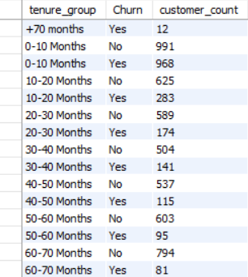
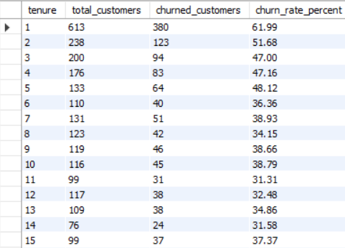
SQL Analysis: Deep Dive into Customer Behavior
SQL was instrumental in preliminary data exploration, segmenting customers, and calculating key churn metrics. This foundational analysis informed our modeling approach and dashboard design.
Tenure Group Segmentation
Monthly Churn Rate
Customers were grouped by tenure (e.g., New, Mid, Long-term) to identify churn patterns across different lifecycle stages.
Calculated the monthly churn rate, providing a real-time pulse on customer attrition.

Slide 5
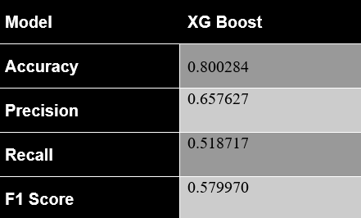
Python Modeling: XGBoost for Churn Prediction
We used Python and scikit-learn to develop and evaluate multiple classification models for predicting customer churn. Each model was trained using a consistent pipeline that addressed data imbalance, feature encoding, and class distribution.
Model & Preprocessing
Model Performance
Model: XGBoost provided the highest accuracy and precision.
Addressing Imbalance: SMOTE (Synthetic Minority Over-sampling Technique) was applied to the training data to counteract the imbalanced churn class, improving model fairness and recall.
Feature Encoding: Categorical features (e.g., 'Gender', 'Contract', 'Partner') were transformed using Label Encoding, converting them into numerical representations suitable for the model.
Target Variable: 'Churn' (Yes/No), indicating whether a customer has churned.
Output
ChurnRisk: Categorical (High, Medium, Low)
ChurnProbability: Numeric (0-1)

Slide 6
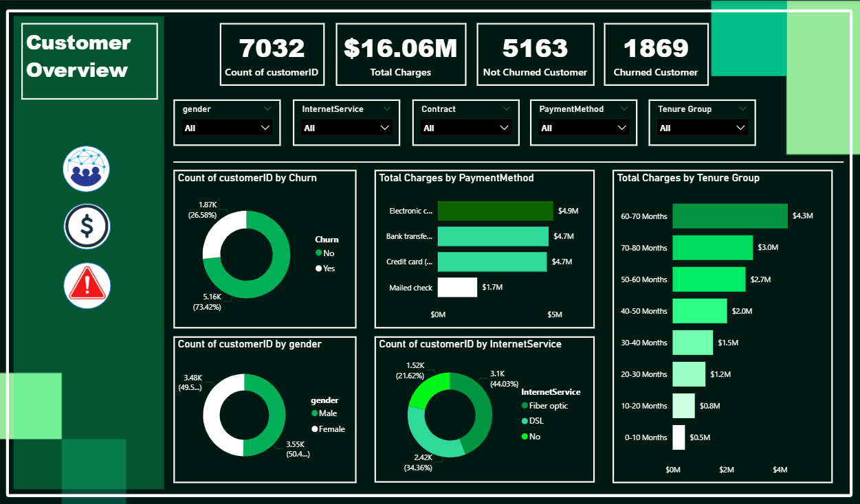
Power BI Dashboard Highlights
The Power BI dashboard serves as the central hub for actionable insights, providing interactive visualizations across three key areas to empower business decision-makers.
Customer Overview :
📊 Majority of customers (73.4%) have not churned.
💳 Electronic Check is the most used payment method by revenue.
📡 DSL dominates internet service type, and most revenue comes from customers with 60–70 months tenure.
.

Slide 7
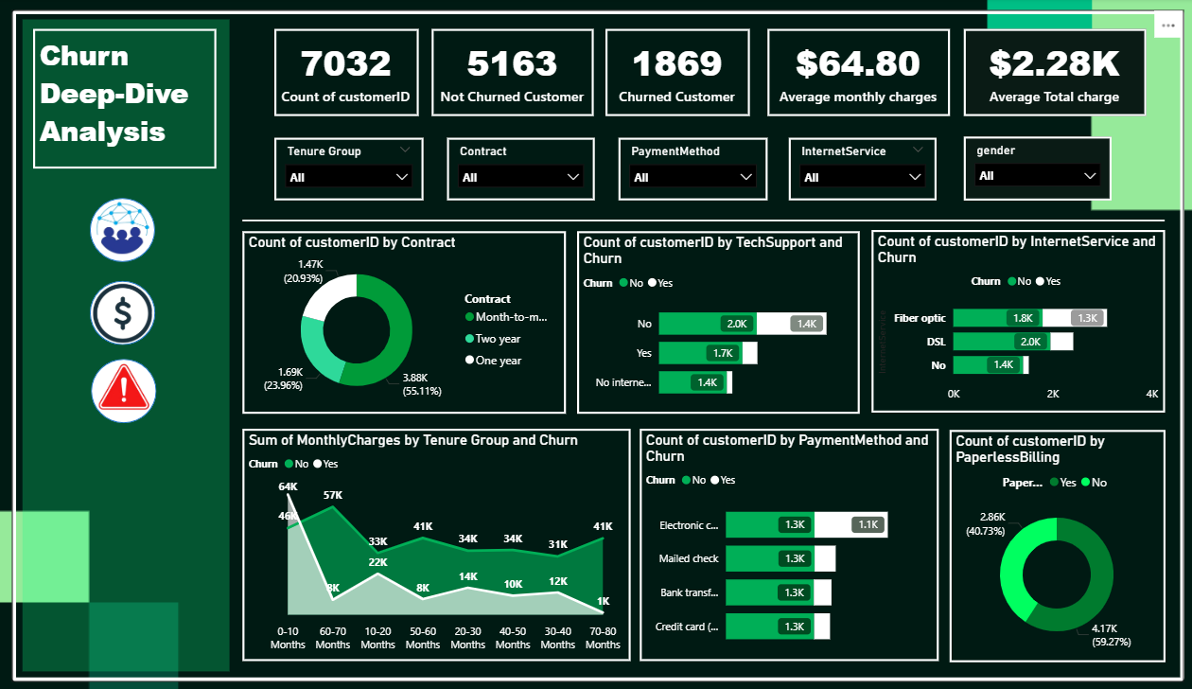
Power BI Dashboard Highlights
Churn Deep-Dive Analysis :
🔁 Churn is highest among Month-to-Month contract users.
‍💻 Lack of tech support and fiber internet are strongly associated with higher churn.
💸 Customers with shorter tenure and lower monthly charges churn more frequently.

Slide 8
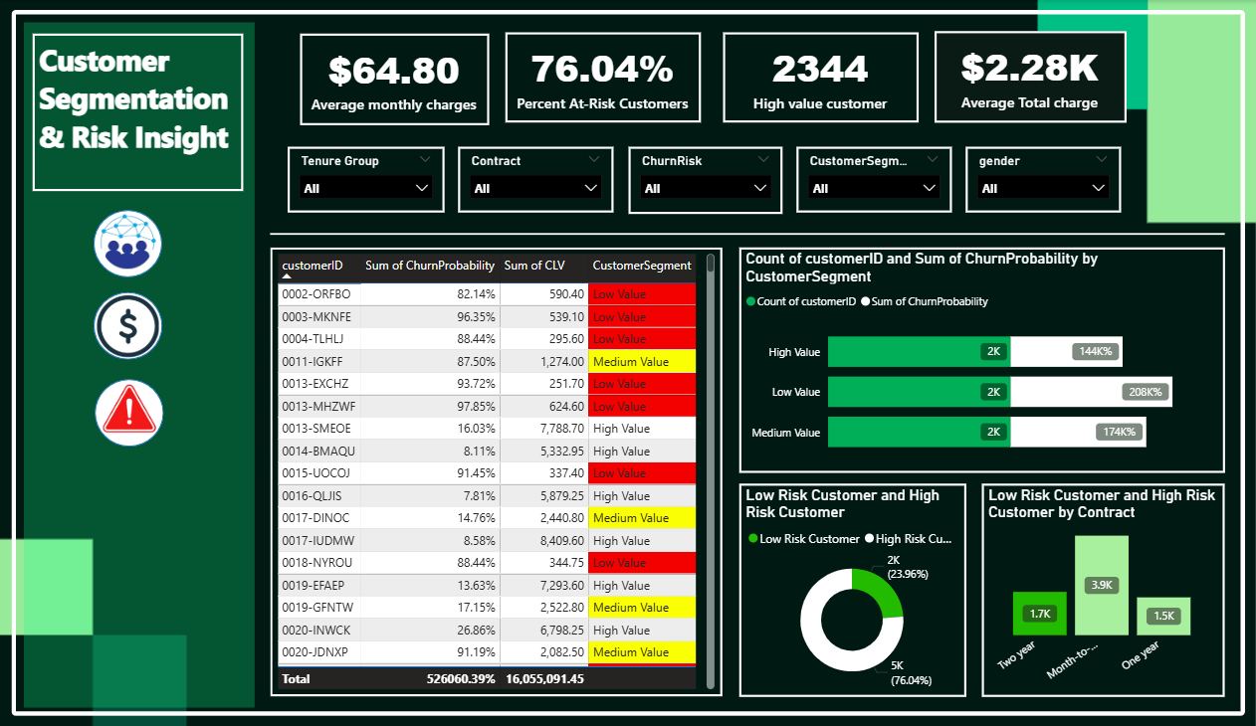
Power BI Dashboard Highlights
Customer Segmentation & Risk Insight :
🚨 Over 76% of customers are at risk of churn. 💰 Many high-value customers also fall under the high-risk segment, indicating urgent retention action is needed. 📊 Segmenting by churn probability and CLV helps prioritize which customers to retain first.

Slide 9
Key Business Insights & Retention Focus
Our analysis revealed critical insights into churn patterns, identifying high-risk segments and highlighting the importance of CLV in retention efforts.
Churn Risk Exposure
Top Churn Drivers
Approximately 76% of the Customer are flagged as at-risk,
SMOTE and proper encoding improved model recall, helping detect more churn-prone customers.
Customers on Month-to-Month contracts, those without Tech Support, and those with high Monthly Charges exhibit the highest churn rates.
CLV-Based Segmentation
Retention Strategy Recommendation
High CLV customers contribute the most to total revenue but are also present in the high-risk churn group.
Prioritize retention efforts on the High-CLV and High-Risk customer group, as losing them would result in the greatest revenue impact.

Slide 10
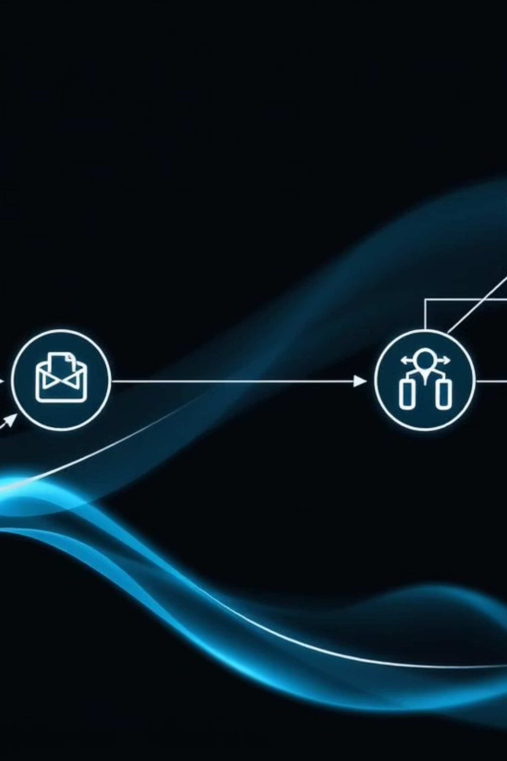




Tools & Workflow Diagram
Our integrated workflow ensures a seamless transition from raw data to actionable business intelligence, leveraging specialized tools at each stage.
SQL Data Preparation
Extracting and transforming raw customer data.
Python Modeling
Building and training the churn prediction model.
Output CSV
Exporting model predictions (Churn Risk, Probability).
Power BI Visualization
Creating interactive dashboards for business insights.

Slide 11



Conclusion & Future Directions
The machine learning model (XGBoost) effectively identifies churn-prone customers with good recall.
SMOTE and segmentation techniques improved prediction fairness and interpretability.
Integration with Power BI empowers business teams to take data-driven retention actions.
Future Enhancements
NLP for Support Tickets
Retention Recommender
Real-time Alerts
Analyze sentiment and themes in customer support interactions to uncover early churn signals.
Develop a system that suggests personalized retention strategies based on customer profile and churn probability.
Implement automated alerts for high-risk customers, integrating directly with CRM systems.

Slide 12

Thank You!
Questions & Discussion

